Slide 1
Spokes-character Branding
Hannah McIntyre

Slide 2
Pilot Question & Hypothesis
How does the use of a spokes-characters affect the persuasiveness of advertising?
Through their personality traits, physical characteristics and advertisements aimed at children, spokes-characters persuade consumers into action and elicit brand loyalty.

Slide 3
Branding
How we decide to buy
Notes:
Branding
branding is a form of persuasion which is defined as “human communication that is designed to influence others by modifying their beliefs, values, or attitudes” (Dainton & Zelley, 2015)
Through a brand, a consumer finds trust, consistency, and a defined set of expectations. They should be unique enough to stand out among the millions of brands on the market. (Mullin, 2006)
Emotions:
Levy- the vast majority of the population consumes and shops with their mind and their heart, or their emotions
Cane- emotion leads to action while reason leads to conclusions
Roberts- Consumers can ask themselves: what does the product do and why is it a superior choice? They can decide, I like it, I prefer it, I feel good about it.

Slide 4
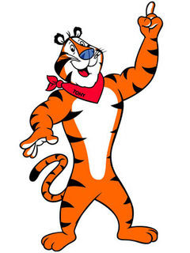
What is a spokes-character?
“Creative elements that promote brand differentiation” (Folse et al., 2012)
humanlike visual images that can symbolically convey a brand’s attributes, benefits, or personality” (Garretson & Burton. 2005)
“an animated being or animated object that is used to promote a product, service, or idea” (Phillips & Gyoerick, 2015)
Original purpose → Modern Purpose
Notes:
Originally, the purpose of a spokes-character was solely “brand identification and differentiation” (Phillips, 1996)
Throughout time, the roles of spokes-characters have grown and developed into a way for consumers to develop relationships with specific brands.
add personality dimensions and source credibility including expertise, trustworthiness, and attractiveness (Kyung & Sung, 2001)

Slide 5
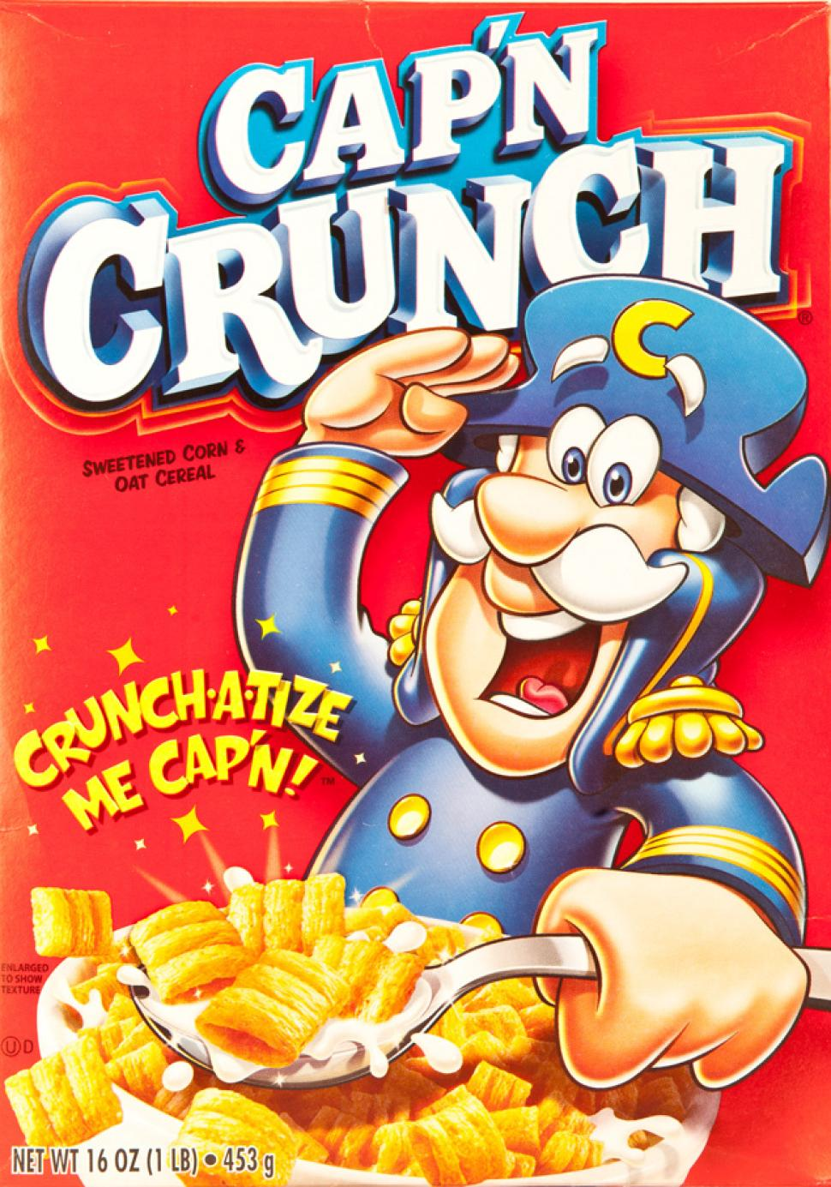
Dimensions of a spokes-character
Personality traits
Physical Characteristics
Advertisements aimed at children
Notes:
Personality traits:
When a spokes-character demonstrates positive personality traits, sincerity and excitement, consumers are more likely to favor and trust the brand in question
Pierce (2001) explains, “they can create a desirable image for the product by linking the personality and cultural meaning of the character to the product in the minds of the consumers,” (p. 849).
Physical Characteristics:
Pierce (2001) found that “changing the gender of a spokes-character changes the perceptions of the product,”
Pierce and McBride (2002) found that male characters tend to be more memorable than women characters because of the fact that more male characters are used. Because of this, they reported that male characters and voices are, in fact, more authoritative
Child:
Children are able to recognize and remember a brand as early as age 2 (Connor, 2006). Marketers aim advertisements with brands at these young children to create brand awareness and loyalty
Animated spokes-characters are an important aspect of advertisements aimed at children because they are visually attractive and evoke brand recognition (Neely & Schumann, 2006)
Though Connor’s study (2006), spokes-characters were often used in advertisements aimed at children and “seemed to be designed to build social or emotional associations with products or brands,”
“a child’s beliefs and desires about a product (or product entity) may be moderated by the child’s affective evaluation of the character,”

Slide 6
Elaboration Likelihood Model
Cacioppo and Petty, 1979
Peripheral route of persuasion
emotions
Persuasion tactics
Peripheral messages
Notes:
when an advertisement has a positive message and is repeated, consumers are more likely to respond positively
This study led them to develop the Elaboration Likelihood Model, which explains how targets of messages in advertisements use mental processes to accept or reject the messages.
Branding and spokes-character advertising use a peripheral route of persuasion. This means the emotions of the consumer are taken into account and the persuasion comes from a more superficial standpoint.
Different tactics, such as authority and commitment, are needed from the brand in order to target the consumer’s emotions. The consumer needs to like the product before they will act in any way.
A peripherally routed message tells the consumer that time is running out: act now; it poses a product next to its competitor and explains why it’s a better version; it shows the consumer what it can provide for them. It targets the consumer’s emotions and causes them to act.

Slide 7
Methodology
convenience sampling
56 surveyed
56% female, 44% male
80% aged 19-21, 16% aged 22-24, 4% aged 31+
total questions:
18 scale
3 nominal
Frequencies, descriptives, crosstabs and Cronbach’s alpha coefficients were run
Scale question categories
Theory questions
RQ questions
Hypothesis questions
Notes:
Theory: questions about emotions, the brand's attractiveness and persuasiveness due to the spokes-character, liking the product
RQ: brand loyalty, aspects of the characters that make them persuasive
Hypothesis: personality traits, physical characteristics and ads aimed at children, staying loyal to brands over time

Slide 8
Frequencies
47% of respondents agree that they are loyal to brands
Apple, Nike, Kellogg, hygiene products
45% of participants strongly agree that they have remained loyal to brands since their youth
Cheerios, Lucky Charms, Frosted Flakes and Coca-Cola
71% of participants agree that a spokes-character can facilitate the success of a product
55% agree that a character needs to be sincere and have energy
33% agree that a character can make someone like the product, but 50% responded neutrally when asked if the character could make you trust the product
Notes:
47% of respondents agree that they are loyal to brands
Apple, Nike, Kellogg, hygiene products
45% of participants strongly agree that they have remained loyal to brands since their youth
Cheerios, Lucky Charms, Frosted Flakes and Coca-Cola
71% of participants agree that a spokes-character can facilitate the success of a product
55% agree that a character needs to be sincere and have energy
33% agree that a character can make someone like the product, but 50% responded neutrally when asked if the character could make you trust the product

Slide 9
Descriptives
Minimums & Maximums
14/18, min 1 and max 5
3/18, min 2 and max 5
1/18, min 3 and max 5
Mean: 2.89 to 5.52
Standard Deviation
12/18, consistent, .501 to .999
6/18, inconsistent, 1.003 to 1.119
Notes:
The descriptive test results showed me that respondents mostly agreed or felt neutral about the questions they were asked. ⅓ of the questions had very consistent answers.

Slide 10
Crosstabs & Alpha Coefficient
Chi Square with .000
Spokes-characters affect children through ads and evoke long term loyalty
Spokes-characters affect children through ads and evoke liking
spokes-character causes consumers to favor a brand and persuades them to buy the product
Spokes-character gender makes consumers like and trust a product
Alpha Coefficient
RQ, .736
Theory, .686
Hypothesis, .782
Notes:
Spokes-characters affect children through ads and evoke long term loyalty
Spokes-characters affect children through ads and evoke liking
spokes-character causes consumers to favor a brand and persuades them to buy the product
Spokes-character gender makes consumers like and trust a product
The results of the alpha tests show that the questions aimed at my theory did not work well together to support the research. However, both the RQ and hypothesis tests proved useful.

Slide 11
Conclusion
Pilot study and hypothesis supported by literature review
Pilot study and hypothesis supported by findings
More surveys
Fewer questions

Slide 12
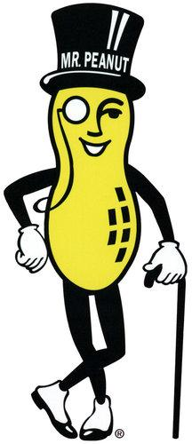
questions?

Slide 13
Image citations
http://assets.nydailynews.com/polopoly_fs/1.1378161!/img/httpImage/image.jpg_gen/derivatives/article_970/cap-crunch.jpg
http://vignette2.wikia.nocookie.net/mms/images/7/76/M%26M_spokescandies.jpg/revision/20131110152857
https://s3.amazonaws.com/rapgenius/tony-tiger.jpg
http://static01.nyt.com/images/2010/11/08/business/adco2/adco2-popup-v2.jpg
http://www.davronmarketing.com/wp-content/uploads/blog-images/branding-matters.png

